Slide 1
Because your company deserves the best space!
Best Office Space on rent in Delhi

Slide 2
Summary
How can you compromise on the structure and aroma of your office when you have a reputation to maintain? This time grab the confidence regarding rentals, facilities and opportunities before you visit and choose the best office space on rent in Delhi.

Slide 3
Searching for a new office space?
Opening new branch or moving your old premises to a new location, the complete procedure develops the hectic schedule for the decision makers. And don’t forget the scanning of new offices that will go on for few weeks before you choose the perfect place. Let’s list the factors that you consider while looking for an office space on rent in Delhi.

Slide 4
3 Points to remember
1: Financial Budget
2: Atmosphere
3: Facilities

Slide 5
1: Financial Budget:
Well there is no doubt in stating that every corporate look for the best premises under the lowest price possible. Sometimes when people are not aware of the region and the competitive prices, they might get fooled about the range later on.
In order to serve the best of your budget, you must browse the important information and data about the region online. That will also help you to develop confidence in your figure to consider office space on rent in Delhi.

Slide 6
2: Atmosphere:
One does appreciate the premises availability under their expected figures, but it is also mandatory to browse the locality properly. That helps in deciding whether it suits the aroma of your services and features of corporate or not.
Such a decision is vital to create and embrace better reputation in front of your clients.

Slide 7
3: Facilities:
Along with your clients, you must spend some effort for your staff as well. It is always appreciated to choose the premises that are easy for your staff to commute to. Along with the same, other facilities like hospitals, restaurant and parking facilities help your staff to focus and motivate their efforts and time in their work. Availability of such facilitates also embark better reputation and branch to work for.

Slide 8
Best properties in south Delhi

Slide 9
Best properties in Nehru place

Slide 10
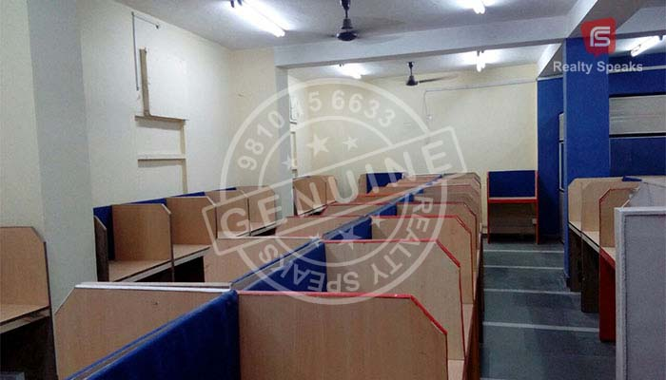
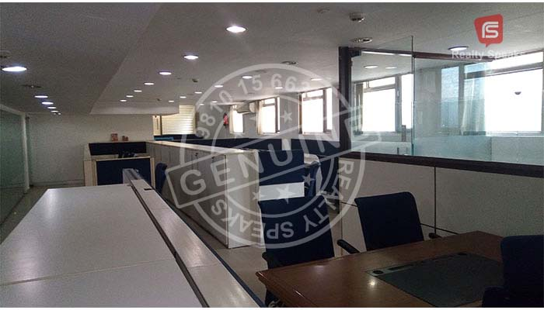
Office for rent in Okhla

Slide 11
Choose the best
An office space on rent in Delhi is a tough challenge, but saves you some unnecessary efforts by browsing the best locality by online information and testimonials. With the increasing number of options and builders in Delhi, it becomes really difficult to opt for the best under your locality expectation. You can attain belter confidence about figures and atmosphere about the region before you actually scan the place physically.

Slide 12
Thus, online platform works like an opportunity for the corporates looking for office space on rent in Delhi without being fooled by the brokers or builders. Don’t’ you want the perfect premises with your choice of locality and atmosphere? Then don’t opt for the choice of your broker but find your own choice and perfection by online scanning.

Slide 13
Conclusion
Your mission of Office space on rent in Delhi will succeed under your figures without compromising any segment or reputation of your brand. Because you deserve the best!

Slide 14
Address:- East of Kailash, New Delhi – 110065
Landmark: Main Road, Opp. Iskcon Temple Phone No: +91-9810 156 633 Email: info@realtyspeaks.com Web: www.officespacesouthdelhi.com

Slide 15
Thanks for watching Have a good time ahead ☺

