Slide 1
Professional Offices in Okhla

Slide 2
Do you want to change your office?
It can be really challenging to look for a professional office in the region like Delhi. With marvelous choices of offices in Okhla, one can welcome better networking platform and clients for a successful turn over.

Slide 3
Why Okhla?
Industrial growth in India has seen a rapid appreciation in terms of profitability and global exposure.
Okhla region in Delhi is a home to automation industrial sectors which stands out to the global standards. With such popularity in the region, corporates are switching their offices in okhla for a better ambience to serve their client and vendors.

Slide 4
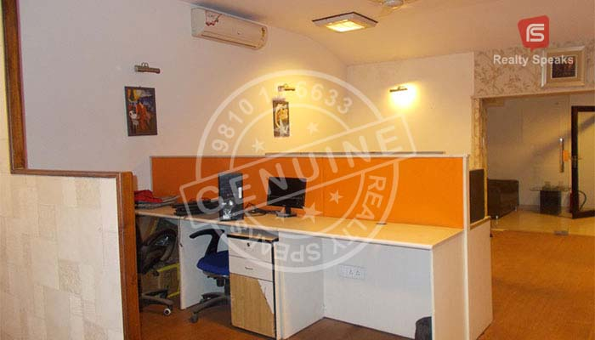
Offices in Okhla
Offices in Okhla are available for rent under competitive price. If you wish to look for the same, you must decide on the following segments for realtors to serve you better:
1. Decide the size
2. Maintain a figure
3. Compare different realtors

Slide 5
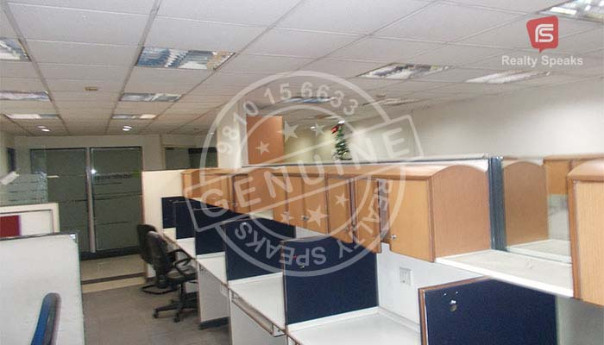
1. Decide the size
One must decide on the size of the premises they are looking for. With various options in different square feet sizes, realtors can serve you accurately once you decide on the premises dimension.

Slide 6
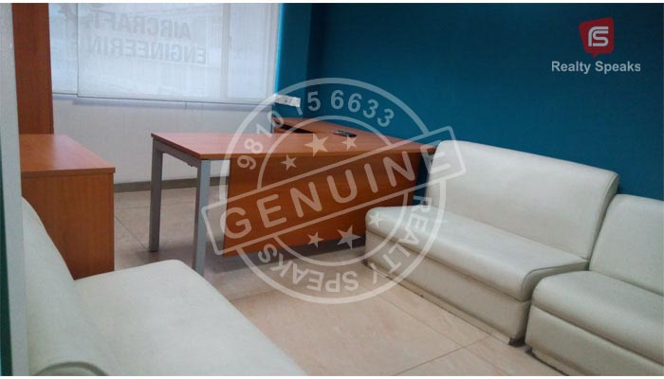
2. Maintain a figure
The companies must decide on the figure they are willing to spend on the rental and maintenance charges. This makes it easier to choose an office in okhla which perfect suites your requirement.

Slide 7
3. Compare different realtors
Through online platform, you can compare several agents and builders available in okhla. With genuine reviews online, you can come up with an easier and smarter selection on the realtor and builder to choose for your requirement.

Slide 8
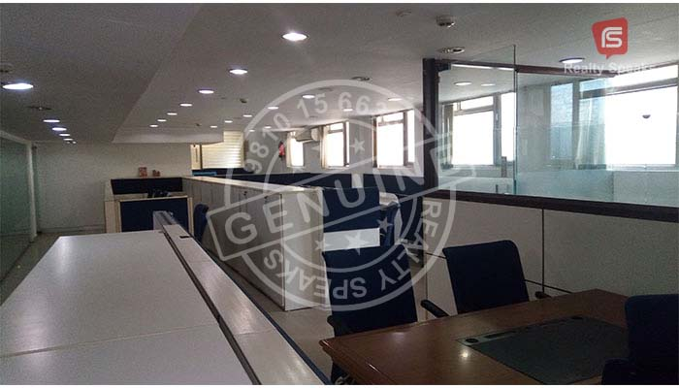
Office Space on rent in Okhla

Slide 10
Conclusion
Once you build better decision based on the mentioned factors, you can realize the dream office you were looking for. A perfect office is a symbolism towards seniority of the services you offer to your clients. And thus, a professional approach towards the search of offices in okhla is a first step to the realization.

Slide 11
Contact Us
Address:- East of Kailash, New Delhi – 110065
Landmark: Main Road, Opp. Iskcon Temple Phone No: +91-9810 156 633 Email: info@realtyspeaks.com Web: www.officespacesouthdelhi.com

Slide 12
Thanks for watching Have a good time ahead ☺

