Slide 1
PLC SCADA Training
Training that offers the best platform

Slide 2
Why PLC SCADA Training?
From personal to professional, technology is ruling every need of human kind. Machines that have an increasing impact on the profitable charts of manufacturing industry is use of PLC SCADA machines. And with PLC SCADA Training, the beneficial platform is served to the graduates who are eager to learn the technological change in terms of automation industry.

Slide 3
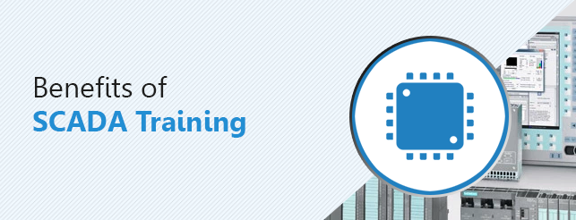
Advantages of Training Program
One of the major advantages of registering of training program is the exposure with the expert professionals in the same field.

Slide 4
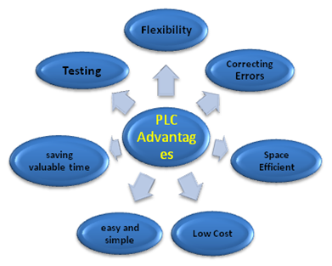
Every procedure involved in manufacturing process are witnessed and examined under the supervision and excellent operational logins of PLC and SCADA systems.

Slide 5
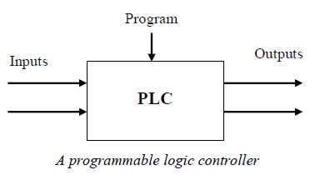
Through PLC SCADA training, You will learn the basic tactics of the machines along with expert guidance on real time data to be programmed under PLC which is a basic credential in automation industry.

Slide 6
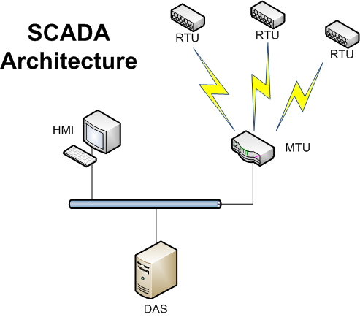
Need of a Professional in Industry
PLC SCADA training is not only an available choice but has become a need for every individual who wants to learn and earn a professional position in automation industry.

Slide 7
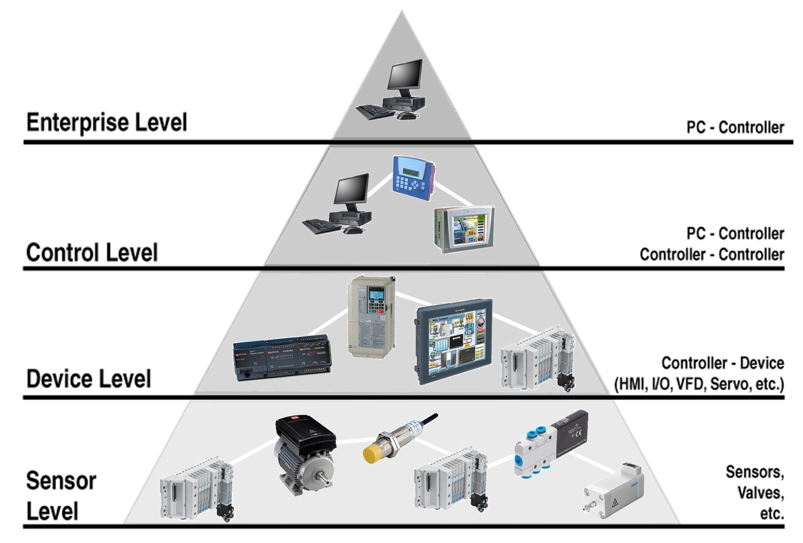

Slide 8
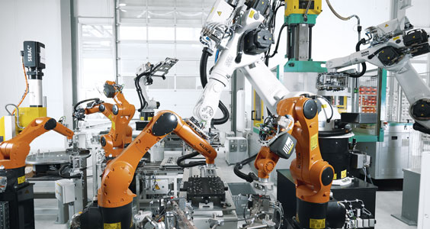
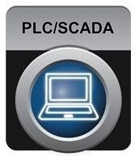
Grow with PLC SCADA Training
If you consider yourself as an enthusiastic young professional, then PLC SCADA training will help you ensure a better place and designation in manufacturing firm.

Slide 9
Components of Automation

Slide 10
OMAC AUTOMATION E-20, Sector -8, Udyog Marg, Noida (U.P.) -201301 Email:-info@omac.in Phone No:- 0120-4117537, 4316909 Mobile:- +91- 9711869909 Website:- www.omac.in

Slide 11
Thanks for watching Have a good time ahead ☺

