Slide 1
Nilkanth Metal
Brass Pressure Gauge Parts Supplier

Slide 2
Company Profile
Since its inception in 2002, Nilkanth Metal created itself as the best manufacturer, supplier, and exporter of different brass products.
Year by year we have kept appending new products to its list. The main aim of Nilkanth Metal is to give excellent quality with total customer satisfaction.

Slide 3
Our Expertise
Dutux is a brand name by Nilkanth Metal, used since 2013 to represent the unique identity of products by Nilkanth Metal. To give the best quality products and total customer satisfaction

Slide 4
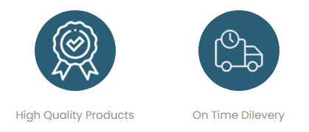
Why Choose Us ?

Slide 5
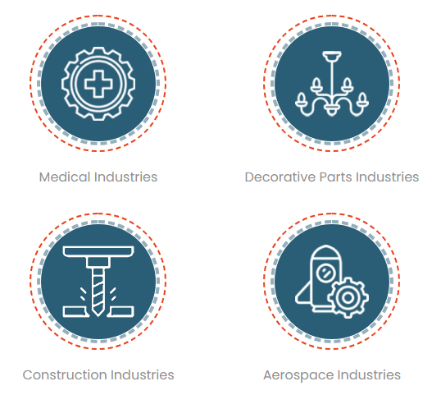
Industries We Serve

Slide 6
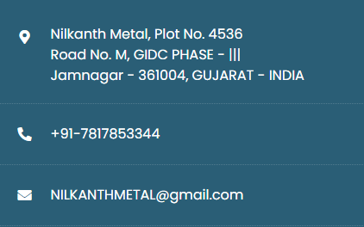
Contact Us

